Slide 1

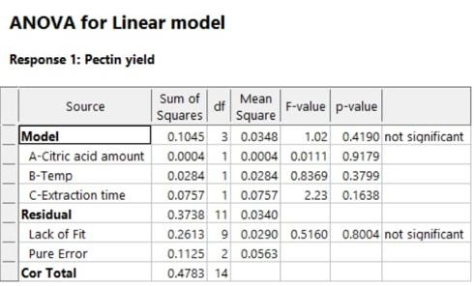
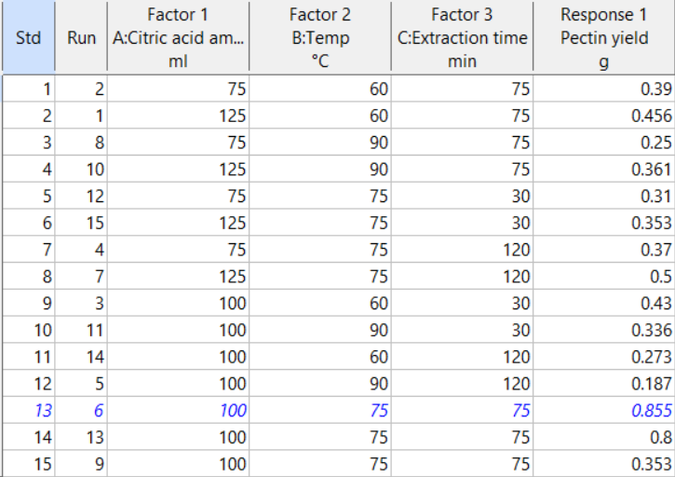
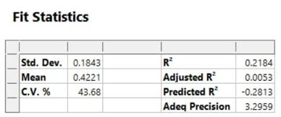
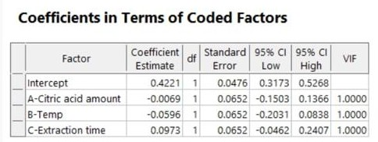
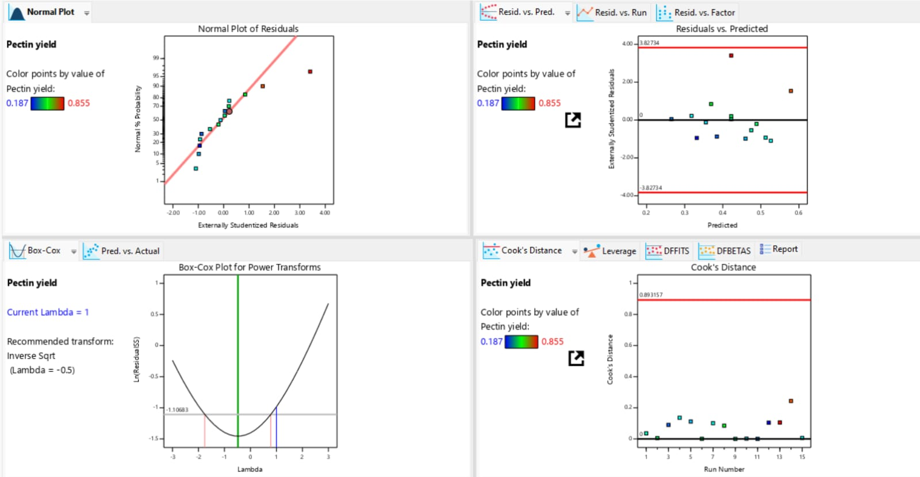
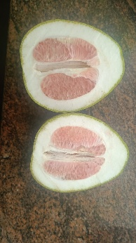
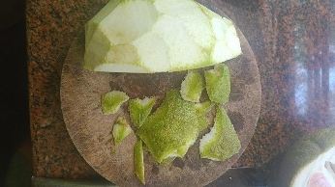
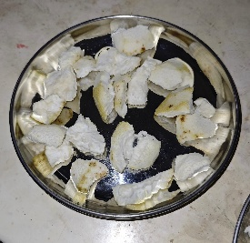
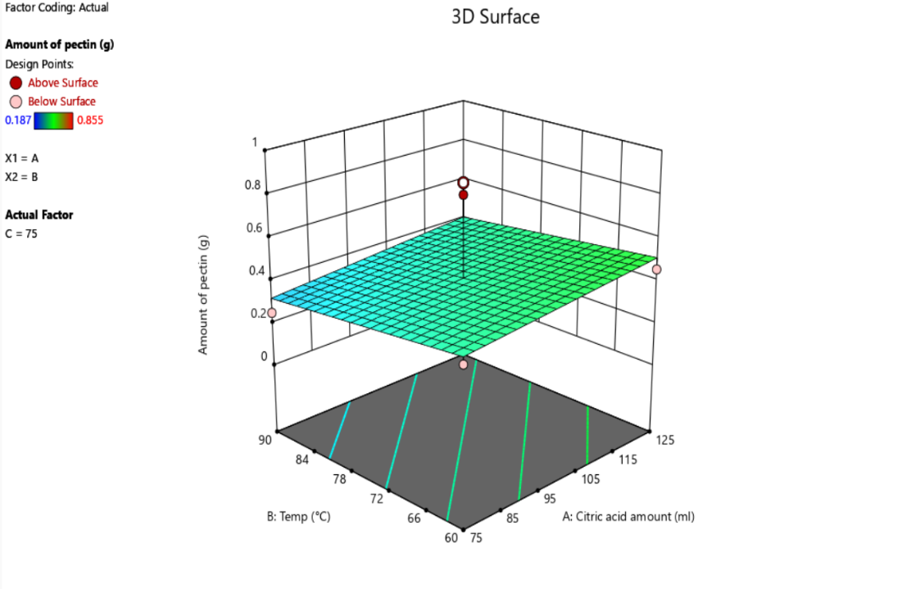
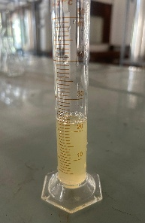
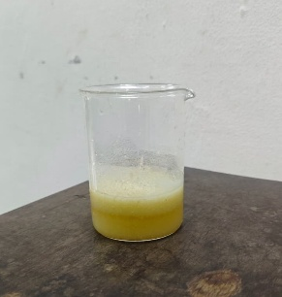
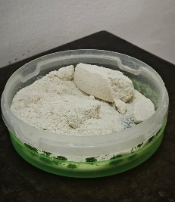
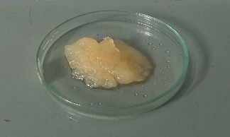
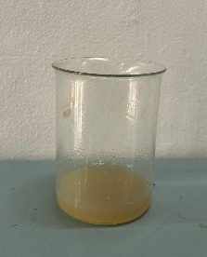
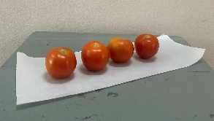
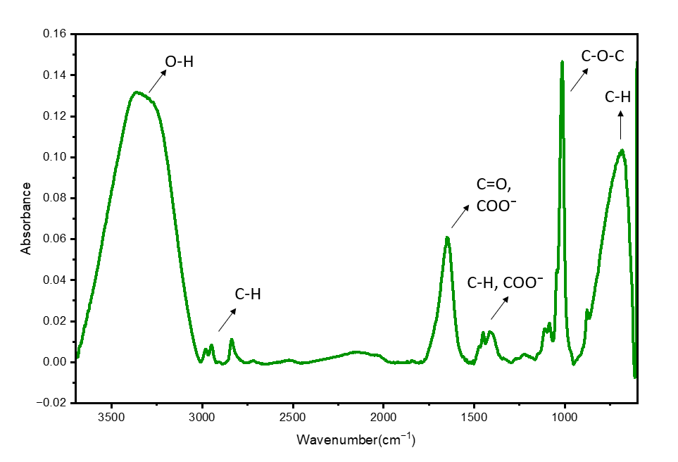
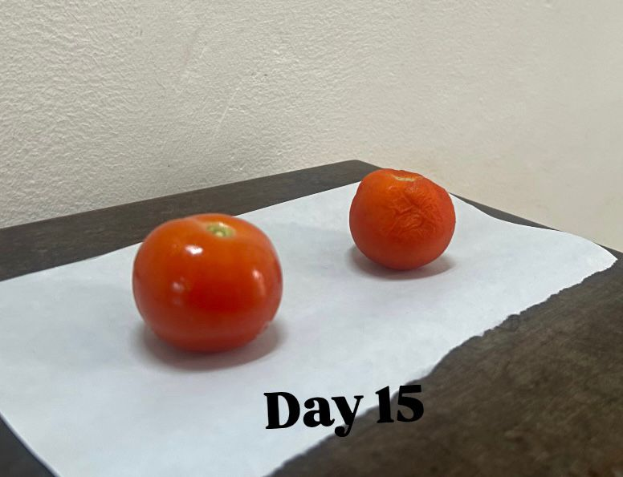
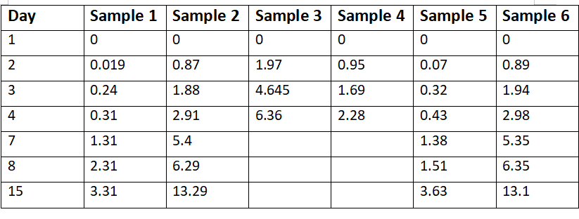
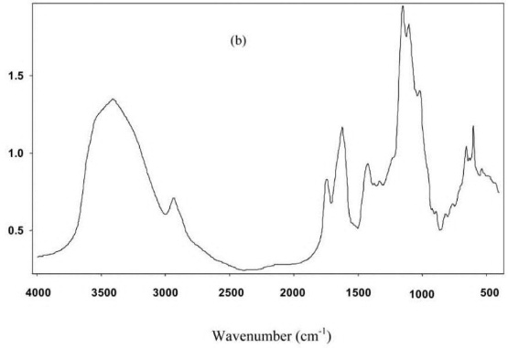
Department of Chemical Engineering
TKM College of Engineering, Kollam-India
28th March 2026
 | EXTRACTION OF VALUE ADDED COMPOUND FROM POMELO PEEL AND ITS APPLICATION AS EDIBLE COATING Amal Pramod ¹ , Bhadhra M Raj ¹ ,Sarah S ¹, Sneha S ¹ , Femina A ¹ ¹Affiliation: Dept. of Chemical Engineering, TKM College of Engineering , Kollam, Kerala, India | Project Group ID: CH05
ABSTRACT
RESULTS AND DISCUSSION
This study investigates the use of pomelo peel as a source of pectin for edible coatings. Pectin was extracted, characterized by FTIR, and used to prepare a coating. The coating was applied to tomatoes and evaluated through weight loss analysis under different storage conditions. Results showed reduced moisture loss and improved shelf-life, especially under cold storage. This highlights the potential of fruit waste-derived pectin as an eco-friendly alternative to synthetic packaging.
PROCESS OPTIMISATION
Design Expert was used for optimisation
Box–Behnken Design (BBD) was used
A type of RSM
All parameters are independent of one another (VIF=1)
Model fits the experimental data (p = 0.8004)
Extraction time has the strongest influence (highest F = 2.23)
21.84% of variability can be explained (R² = 0.2184)
Reasonable consistency in experimental results (σ=0.1843)
Pectin yield ∝ Time
Pectin yield ∝ 1/Temp
Pectin yield ∝ 1/Citric acid amt
OBJECTIVES
Extraction of pectin from Pomelo peel
Characterisation using FTIR
Process optimization of pectin extraction
Edible coating preparation
Comparitive Study
METHODOLOGY
Highest yield was obtained in 6th run
Raw material collection
Cleaning, Drying & Grinding
Hot acid extraction of pectin using citric acid.
Centrifugation
Gel Pectin separated using ethanol
Centrifugation
Dried
Edible coating preparation
Comparitive study
Regression model:
Yield = 0.4221 − 0.0069A −
0.0596B + 0.0973C
A = citric acid amount
B = temperature
C = extraction time
3D surface plot is a visualization tool
No abrupt fluctuations
Process tolerance is high
Low prediction error
Minimal risk of over-processing
Model is stable and well-behaved
Effect of time > temp > citric acid amt
3D Surface Plot
FTIR ANALYSIS
EDIBLE COATING
The observed functional groups indicate that the extracted pectin retained its structural integrity without significant chemical degradation.
Edible coating was prepared. It was coated on 3 tomatoes with avg thickness of 0.5mm. 2 of them were kept under cold condition and 1 in ambient condition. This was compared with uncoated tomatoes. Weight loss analysis was carried out.
% Weight loss of tomatoes
Sample 1 - Cold, Coated
Sample 2 - Cold, Uncoated
Sample 3 - Ambient, Coated
Sample 4 - Ambient, Uncoated
Sample 5 - Cold, Coated
Sample 6 – Cold, Uncoated
The spectrum is consistent with reported FTIR profiles of pectin, confirming the successful extraction
Reference graph from [2]
REFERENCES
CONCLUSIONS
[1] Urias-Orona, V., Rascón-Chu, A., Lizardi-Mendoza, J., Carvajal-Millán, E., Gardea, A. A., & Ramírez-Wong, B. (2010). A novel pectin material: extraction, characterization and gelling properties. International journal of molecular sciences, 11(10), 3686-3695.
Pectin was successfully extracted from pomelo peel, demonstrating its potential as value added compound.
The coating exhibited reduced weight loss and improved shelf life especially under cold storage condition.
The study confirmed that pomelo peel pectin is a sustainable, biodegradable alternative to synthetic packaging
ACKNOWLEDGEMENT
We thank the Dept. of Chemical Engineering TKM College of Engineering for providing us with all required facilities

